Slide 1

Nonparametric Analysis of Agricultural Productivity In U.S.
Sofia Moroni
Nonparametric Statistics (5 CFU)
MSc. Mathematical Engineering

Slide 2
RESEARCH QUESTIONS
01
02
03
The project addresses Policymakers of US and their Economic Advisers
How Agricultural Growth has changed from the past
Which are the Primary Drivers of the agricultural sector’s growth
Which States are leading in Agricultural Production and why

Slide 3
DATASET PRESENTATION
For each U.S. State
National Level Observations
Total Agricultural Output
YEAR
from 1960 to 2004
YEAR
from 1948 to 2019
Intermediate Input
Labor Input
Capital Input

Slide 4

DATASET PRESENTATION
The variables are indexes of growth with respect to year 2015
Total Agricultural Output
Gross production leaving the farm
Capital Input
Wide range of physical assets used in agricultural activities
Intermediate Input
Resources used within the production process but not directly transformed into the final output
Labor Input
Total human effort in agricultural production
Durable Equipment
Service Buildings
Inventories
Land
Feed and Seed
Fertilizer
Energy
Pesticides
Purchased Services
Hired Labor
Self Employed & Unpaid Family

Slide 5
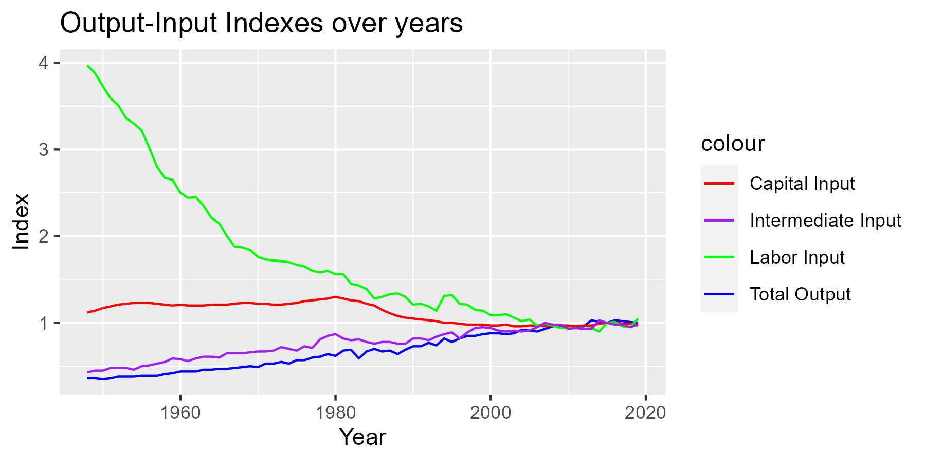
GENERAL TRENDS IN DATA
Different composition of Inputs along Years
Human Labor
&
Land (Capital Input)
Farm Machinery
(Capital Input)
&
Intermediate Resources
From
Towards

Slide 6
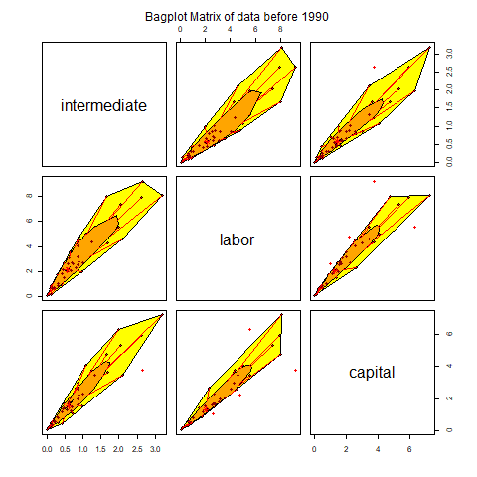
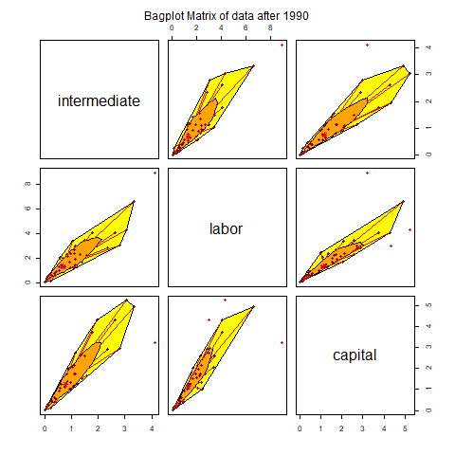
GENERAL TRENDS IN DATA
Two Paired Samples Multivariate Permutational test
There is statistical evidence of difference between the means of first period and second period

Slide 7
SPEARMAN CORRELATION
 | Total Output 48-90 | Total Output 90-2015
Capital Input | 0.1656040 | - 0.3183969
Labor Input | - 0.9876408 | - 0.8513482
Intermediate Input | 0.9568786 | 0.7858585
Intermediate Input: strongly positive correlation
Labor Input: excessive or inefficient allocation of labor reduction in productive efficiency
Capital Input : shift from weakly positive to negative changes in agricultural technologies, resource allocation or market dynamics

Slide 8
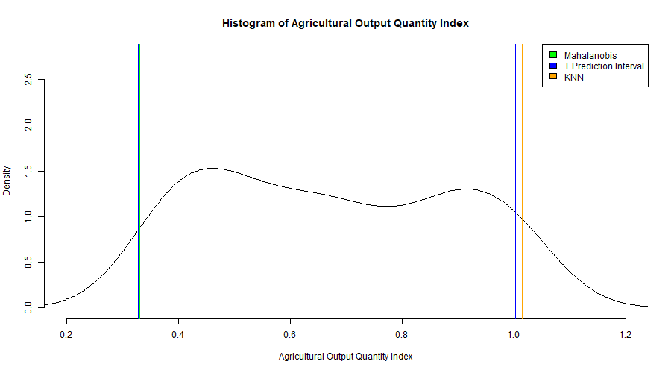
CONFORMAL PREDICTION
Conformal Intervals
Mahalanobis distance
T prediction interval
KNN distance

Slide 9
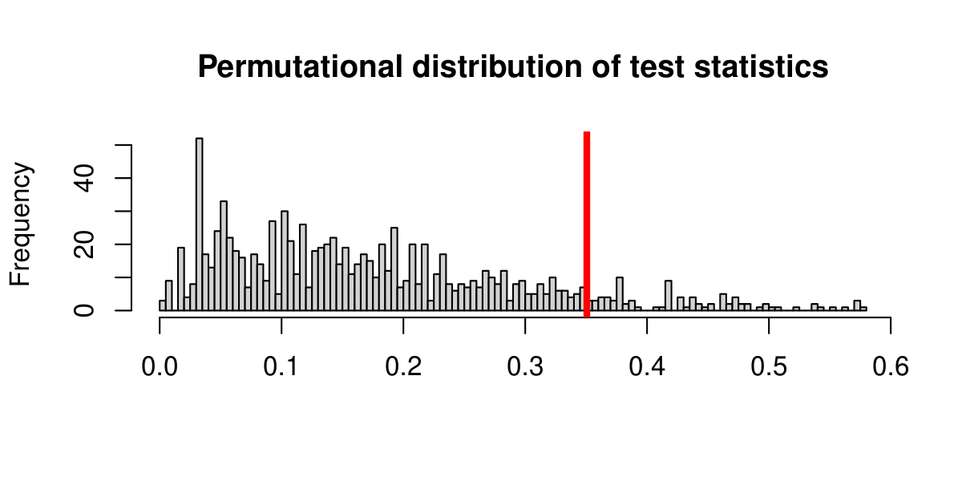
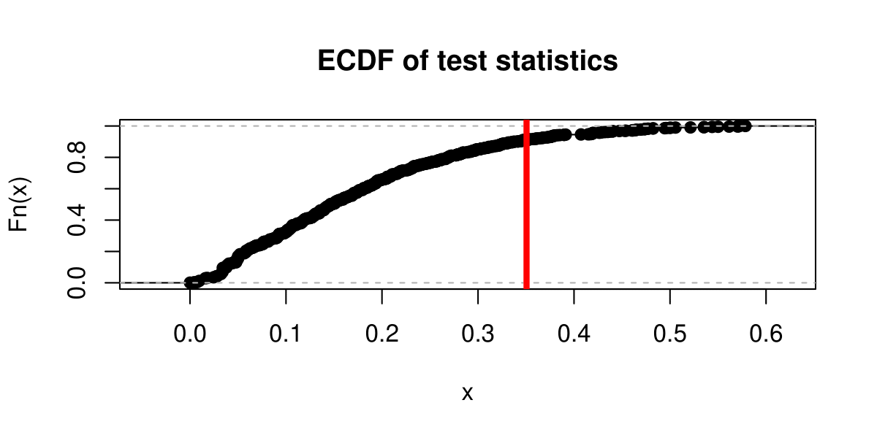
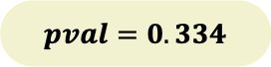
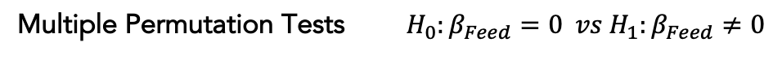
GAM
Multiple Permutation Tests $H_{0}:β_{Feed}=0 vs H_{1}:β_{Feed}≠0$
to assess the significance of each covariate
$$pval=0.334$$

Slide 10
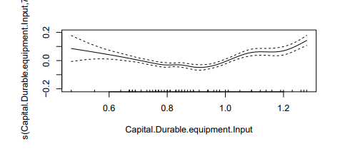
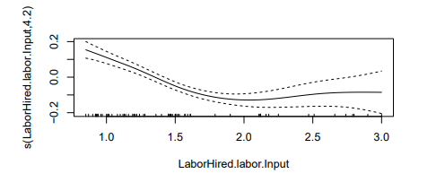

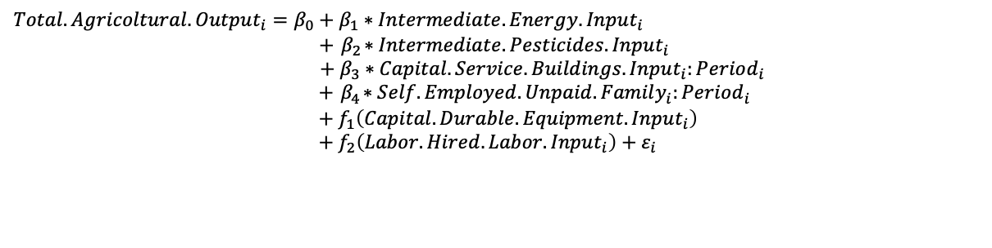
GAM
$Total.Agricoltural.Output_{i}=β_{0}+β_{1}∗Intermediate.Energy.Input_{i}$ $+{ β}_{2}∗Intermediate.Pesticides.Input_{i}$ $$+ β_{3}∗Capital.Service.Buildings.Input_{i}:Period_{i}$$ $+{ β}_{4}∗Self.Employed.Unpaid.Family_{i}:Period_{i}$ $$+ f_{1}\left(Capital.Durable.Equipment.Input_{i}\right)$$ $+ f_{2}\left(Labor.Hired.Labor.Input_{i}\right)+ε_{i}$
$$β_{1},β_{2},β_{3,2}>0$$
$$β_{3,1},β_{4,1},β_{4,2}<0$$

Slide 11
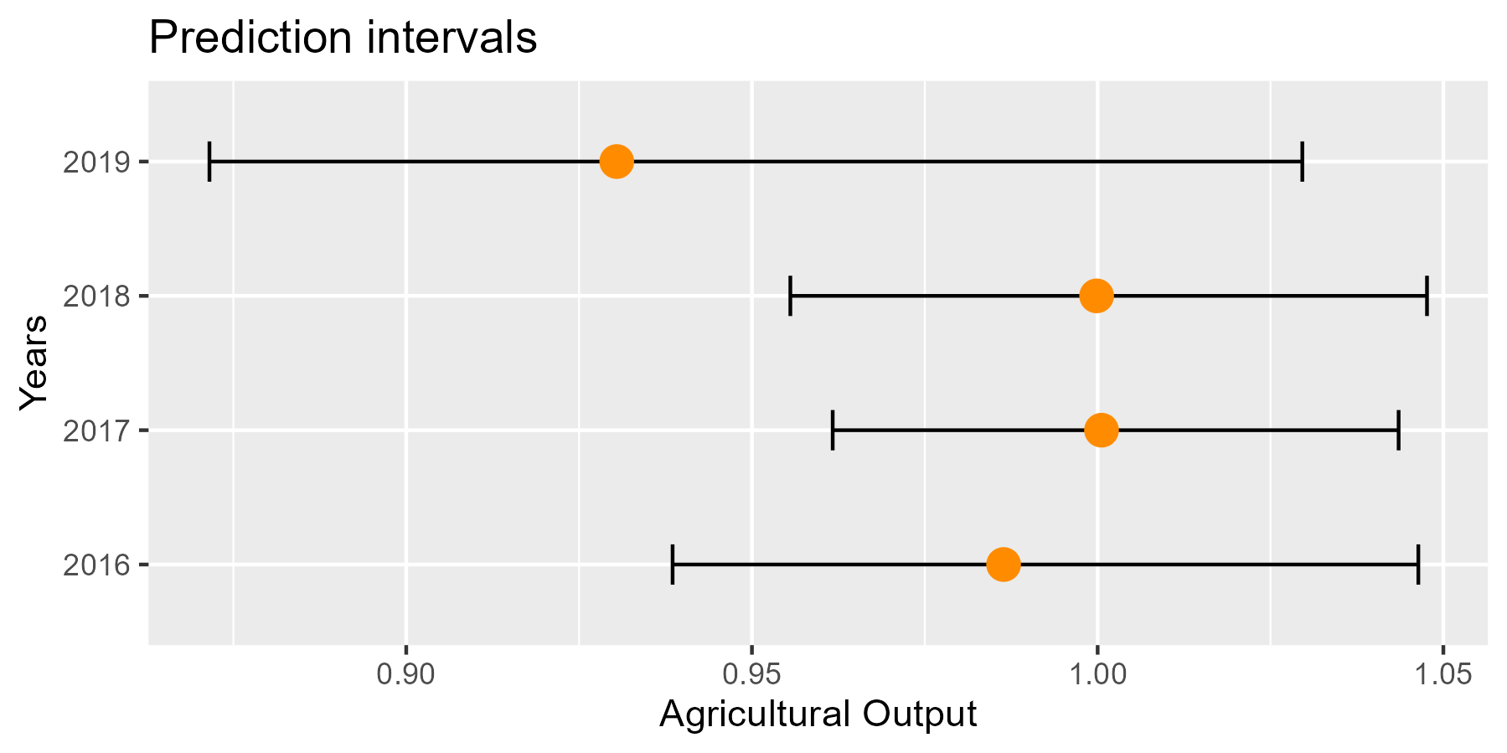
GAM
Prediction of years 2016-2019 using GAM covariates
+
Reverse Percentile (Bootstrap) intervals 𝛼=0.1
Comparison with true data
Prediction of 2019 underscores the challenge of accurately predicting outcomes when considering dynamic, external factors

Slide 12
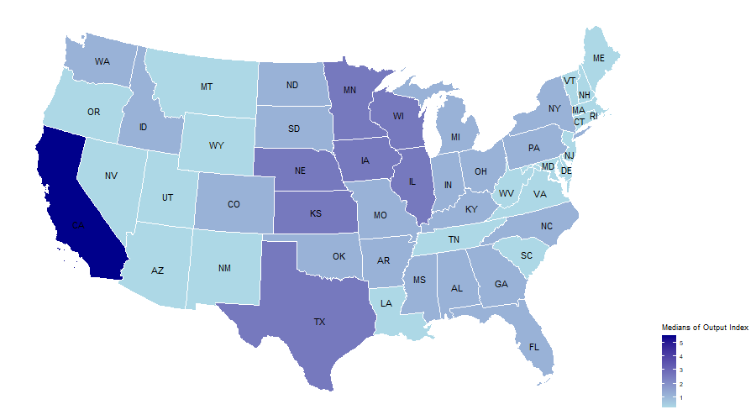
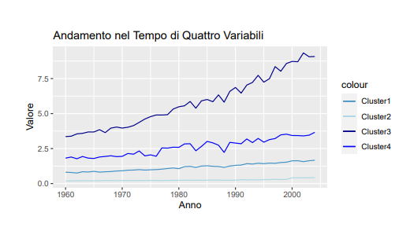
SEQUENTIAL CLUSTERING
Identify 4 clusters exhibiting similar patterns over years
Sequential Clustering based on Agricultural Output Index
Clusters Trend along years
Value
Year
Singleton California has values significantly higher than those of other state

Slide 13
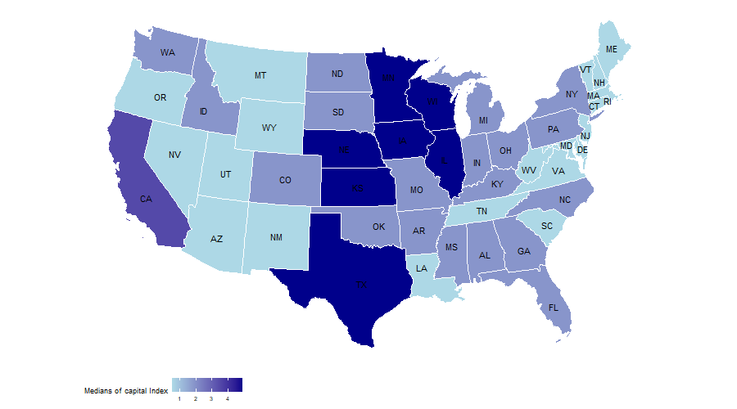
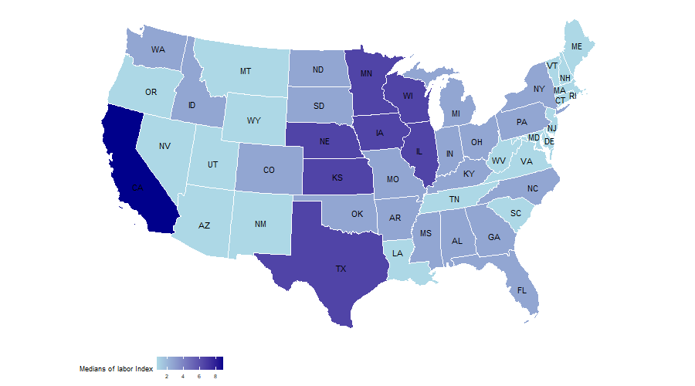

PERMUTATIONAL MANOVA
Permutational Manova Analysis on Capital Input, Labor Input and Intermediate Input
Clustering not only captures output distinctions but also reflects statistically significant variations in the use of inputs
Intermediate Input
Capital Input
Labor Input

Slide 14
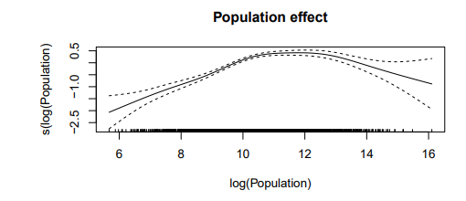
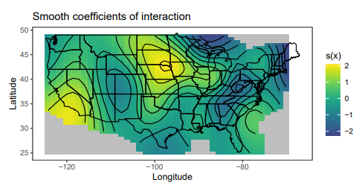
SPATIAL ANALYSIS
Areas with high sales could indicate regions with a strong demand for agricultural commodities and a higher necessity for agricultural productivity
Spatial GAM to identify regions with the highest sales of agricultural commodities
$$\log\left(Total_Commodities_Sales\right)=f_{1}\left(Latitude,Longitude\right)+f_{2}\left(\log\left(Population\right)\right)$$

Slide 15
CONCLUSIONS
Conclusions
Further Developments
Changes In Input Usage
Permutational Tests
01
Include in the analysis external factors, such us weather conditions or characteristics of the soil
Employ more sophisticated modeling techniques to understand complexity of the dynamics of agricultural systems
Primary drivers of the agricultural sector
GAM + Bootstraps Intervals
02
Spatial Agricultural Trends
Permutational Manova + Spatial GAM
03

Slide 16
Thanks for your attention!

Slide 17
References
Ball et al. Is u.s. agricultural productivity growth slowing? Applied Economic Perspectives and Policy, 2013.
Wang et al. Public r&d, private r&d, and us agricultural productivity growth: Dynamic and long-run relationships. American journal of agricultural economics, 2013.
Sun Ling Wang, Paul Heisey, David Schimmelpfennig, and V Eldon Ball. Agricultural productivity growth in the united states: Measurement, trends, and drivers. Economic Research Service, 2015.
Sun Ling Wang, Richard Nehring, and Roberto Mosheim. Agricultural productivity growth in the united states: 1948-2015. Amber Waves: The Economics of Food, Farming, Natural Resources, and Rural America, 2018(2), 2018.

